Slide 1




Educational Resource
Life on the Western Front - Trench Warfare

Slide 2
This PowerPoint presentation contains a selection of images and archives which students can use to explore the story of one British soldier in the First World War. In the main, the materials come from the Collection of the Mercian Regiment Museum, Worcestershire (MRM).
These images can be used to build up a picture of an individual soldier’s experience of service in the First World War. These images can encourage literacy and visual literacy. Suggestions for questions you might discuss with your students are included in the notes.
Unless otherwise stated in the notes, the images can be freely used for non-commercial purposes within the classroom. You can use the entire presentation or choose individual images for use in other non-commercial contexts. When using individual images in other contexts, please always retain the attribution statements provided in this document (e.g. MRM 2015-1).
By downloading this document and using these images you agree to these terms of use, including your use of the attribution statement specified for each object by MRM.

Slide 3
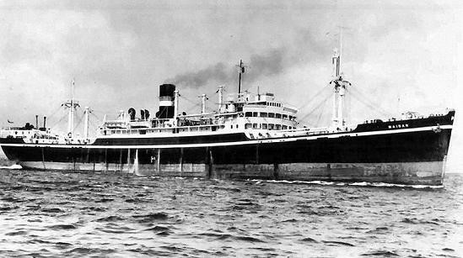
In August 1914 Germany invaded Belgium and France and Britain therefore declared war on Germany. The British Army (known as the British Expeditionary Force or BEF) landed in France and some major battles occurred as they tried to halt the German advance.
S.S. Maidan which transported the 1st Battalion to France

Slide 4
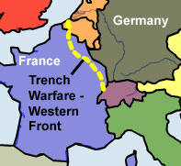
Very quickly both sides dug in to form a line of defensive trenches to protect their positions. They stretched across France from the coast to the North Sea to the border with Switzerland in the south.

Slide 5
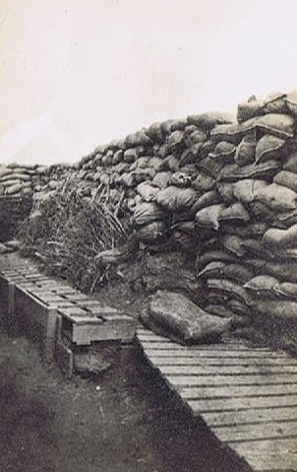
Trenches were long, narrow ditches dug into the ground. The Front Line of the British and German trenches faced each other, with an area called No Mans Land in-between. When one side attacked another they crossed this exposed area into the firing line of the other side.
© Mercian Regiment Museum (Worcs.)

Slide 6
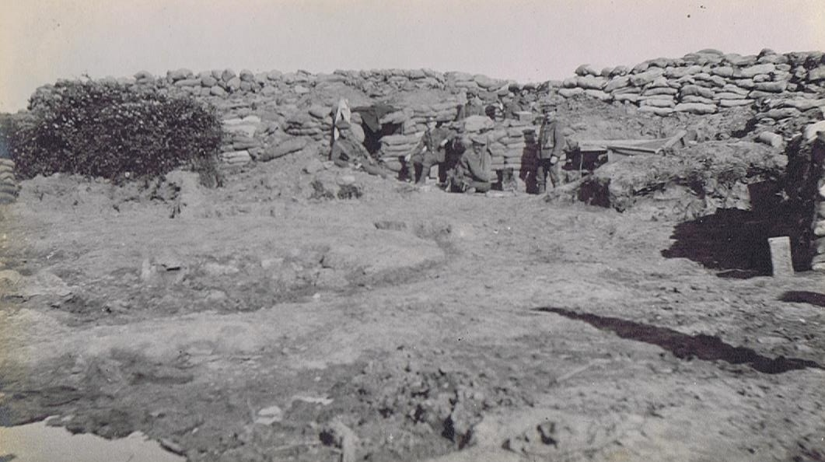
© Mercian Regiment Museum (Worcs.)
Front Line, Ypres Salient

Slide 7
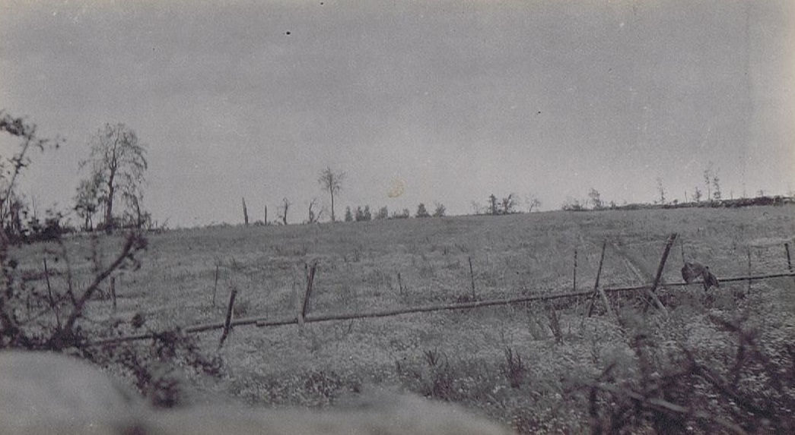
© Mercian Regiment Museum (Worcs.)
No Man’s Land

Slide 8
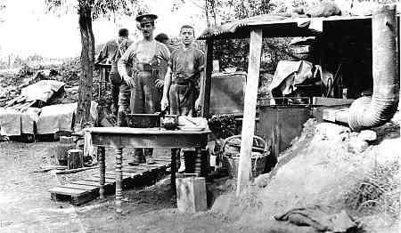
© Mercian Regiment Museum (Worcs.)
There were usually several lines of trenches, with a Reserve Trench behind the Front Line. Soldiers rotated between the front line and reserve areas. Messages and supplies were sent via Communication Trenches.

Slide 9
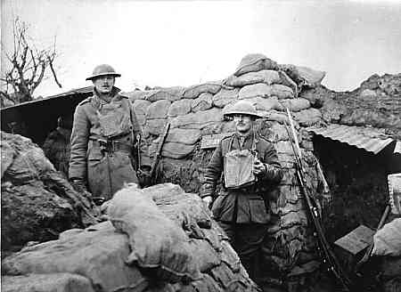
Soldiers in the front line lived in trenches all day and night. They did not get much sleep. Most of their time was spent on chores.
© Mercian Regiment Museum (Worcs.)

Slide 10
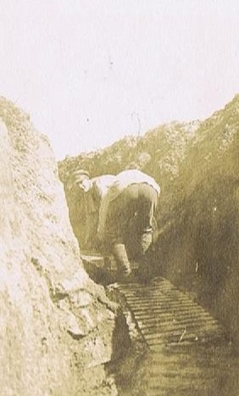
Trench life was very monotonous, dull and tiring– they did things like cleaning weapons; building and repairing trenches; fetching supplies; observing enemy activity. But soldiers lived in constant fear of their lives.
© Mercian Regiment Museum (Worcs.)

Slide 11
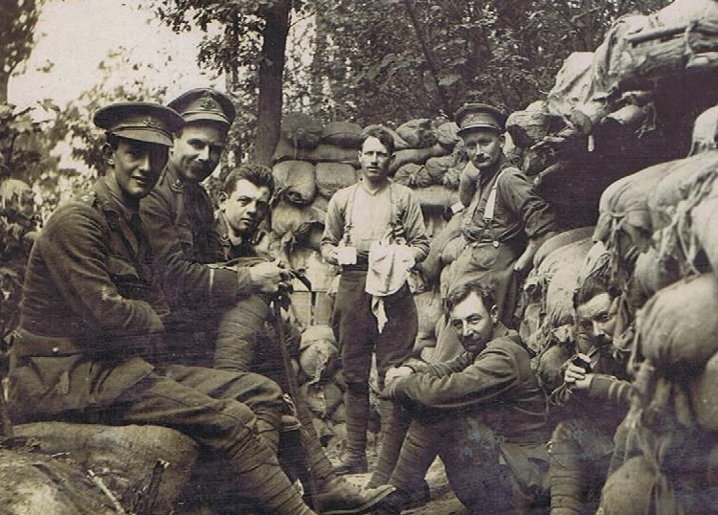
© Mercian Regiment Museum (Worcs.)
Trenches were cramped and dirty.

Slide 12
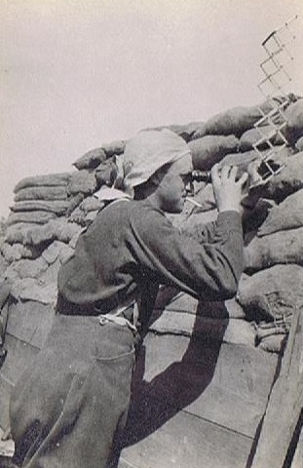
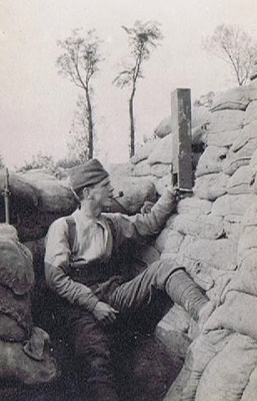
Observing the enemy with different kinds of periscope to avoid gunfire.
© Mercian Regiment Museum (Worcs.)
© Mercian Regiment Museum (Worcs.)

Slide 13
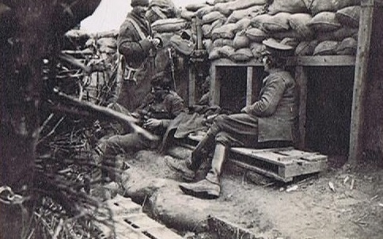
In the front line.

Slide 14
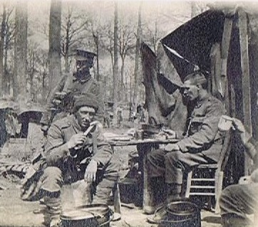
The food soldiers received was unappetising. It consisted mainly of bully beef (canned corned beef), bread and biscuits. Food was usually cold by the time it reached the soldiers.
© Mercian Regiment Museum (Worcs.)

Slide 15
The closeness to dead bodies and overflowing toilets meant that trenches were often a breeding ground for infestation and disease. Rats and lice were endemic. Many soldiers suffered from illness rather than wounds.

Slide 16
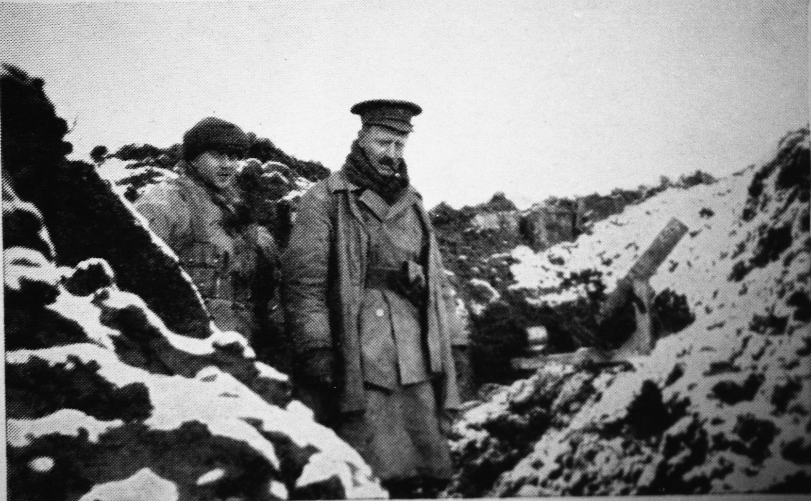
© Mercian Regiment Museum (Worcs.)
Trenches were open and exposed to all weather conditions. The winter months were very hard. When it rained the trenches frequently filled with water and soldiers’ boots were wet through. Trench Foot was a form of frostbite, a painful illness caused by long immersion in cold water or mud.

Slide 17
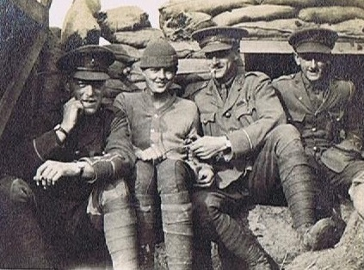
© Mercian Regiment Museum (Worcs.)
Comradeship amongst the men was important.

Slide 18
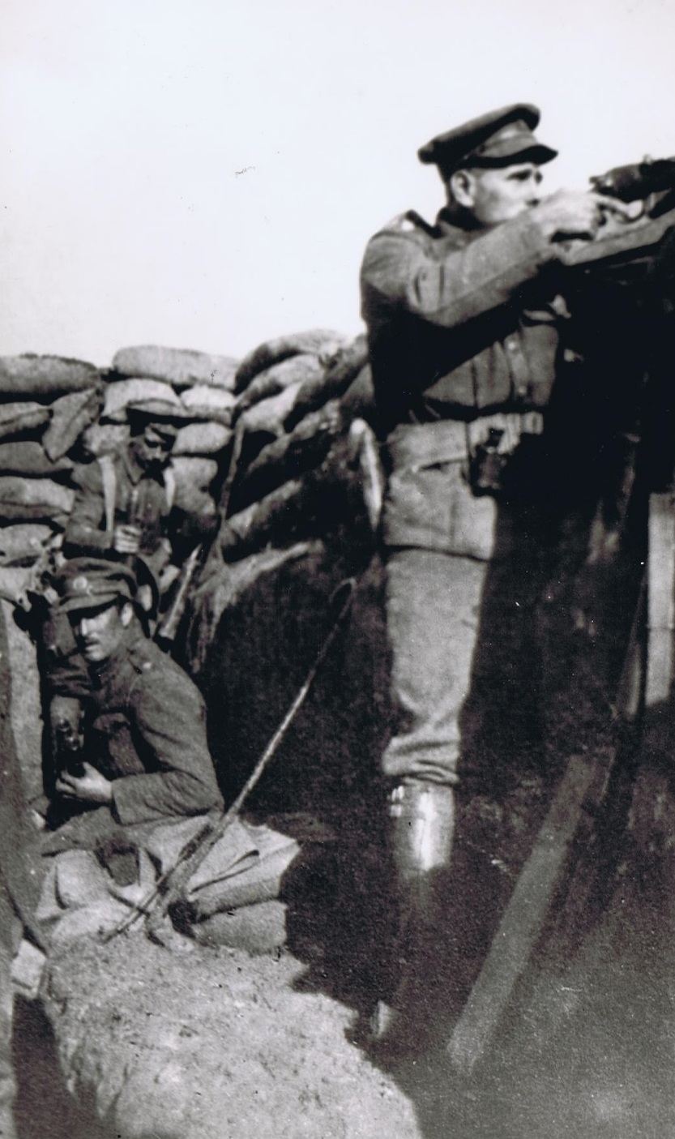
A soldier fires a rifle from the trench into the enemy lines. When the troops attacked, climbing over the trench was known as going over the top.
© Mercian Regiment Museum (Worcs.)

Slide 19
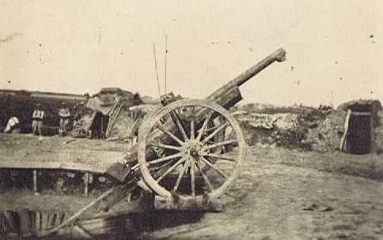
© Mercian Regiment Museum (Worcs.)
Modern weapons were very deadly – grenades, mines, machine guns, poisonous gas. Casualties on the Front were very high; particularly during ‘a big push’ (a major attack).
A field gun modified into a Howitzer

Slide 20
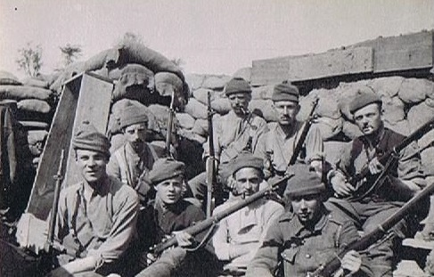
© Mercian Regiment Museum (Worcs.)
Long Lee Enfield Rifles in use by No. 9 Platoon, 1/8th Worcestershire Regiment

