Slide 1




Educational Resource
Sample WW1 Soldier –
Private William Hadley

Slide 2
This PowerPoint presentation contains a selection of images and archives which students can use to explore the story of one British soldier in the First World War. In the main, the materials come from the Collection of the Mercian Regiment Museum, Worcestershire (MRM).
These images can be used to build up a picture of an individual soldier’s experience of service in the First World War. These images can encourage literacy and visual literacy. Suggestions for questions you might discuss with your students are included in the notes.
Unless otherwise stated in the notes, the images can be freely used for non-commercial purposes within the classroom. You can use the entire presentation or choose individual images for use in other non-commercial contexts. When using individual images in other contexts, please always retain the attribution statements provided in this document (e.g. MRM 2015-1).
By downloading this document and using these images you agree to these terms of use, including your use of the attribution statement specified for each object by MRM.

Slide 3
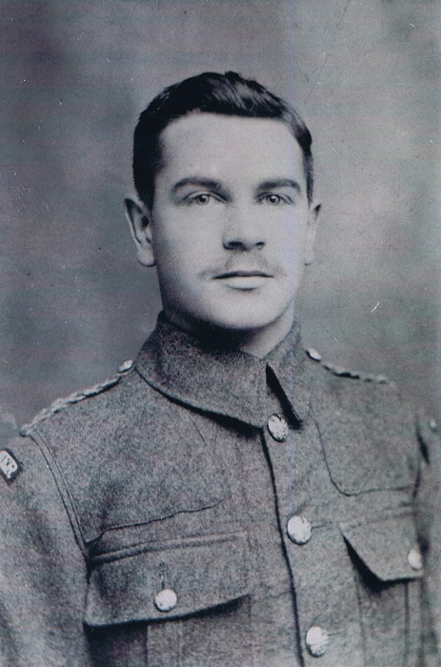
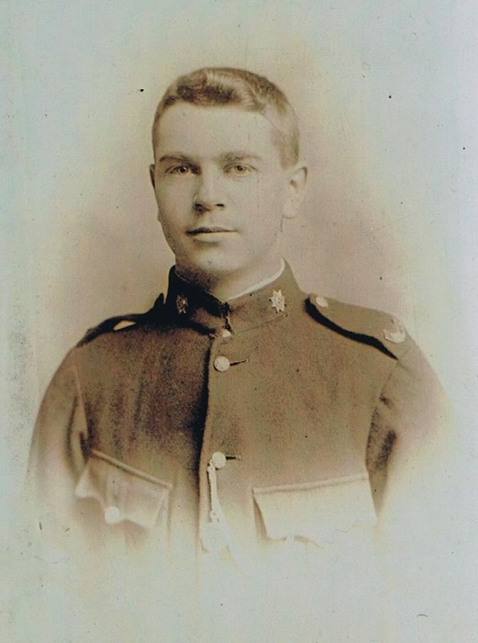
© Mercian Regiment Museum (Worcs.)
© Mercian Regiment Museum (Worcs.)
Private William Hadley

Slide 4
William Hadley was born in Dudley on 30th January 1884, the son of Mary and William Hadley, a blast furnaceman. He had 4 brothers and three sisters. He worked as an iron and steel dresser. He was a keen footballer.

Slide 5
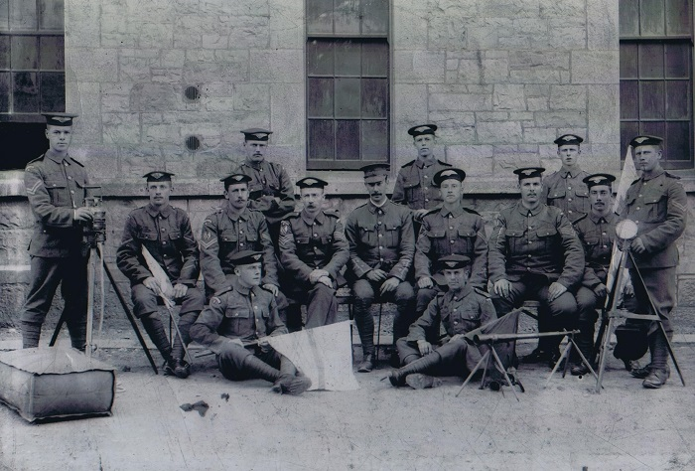
© Mercian Regiment Museum (Worcs.)
William enlisted in the Worcestershire Regiment before the First World War on 25th June 1903. This photograph was taken in 1904 at Tipperary Barracks, Ireland.

Slide 6
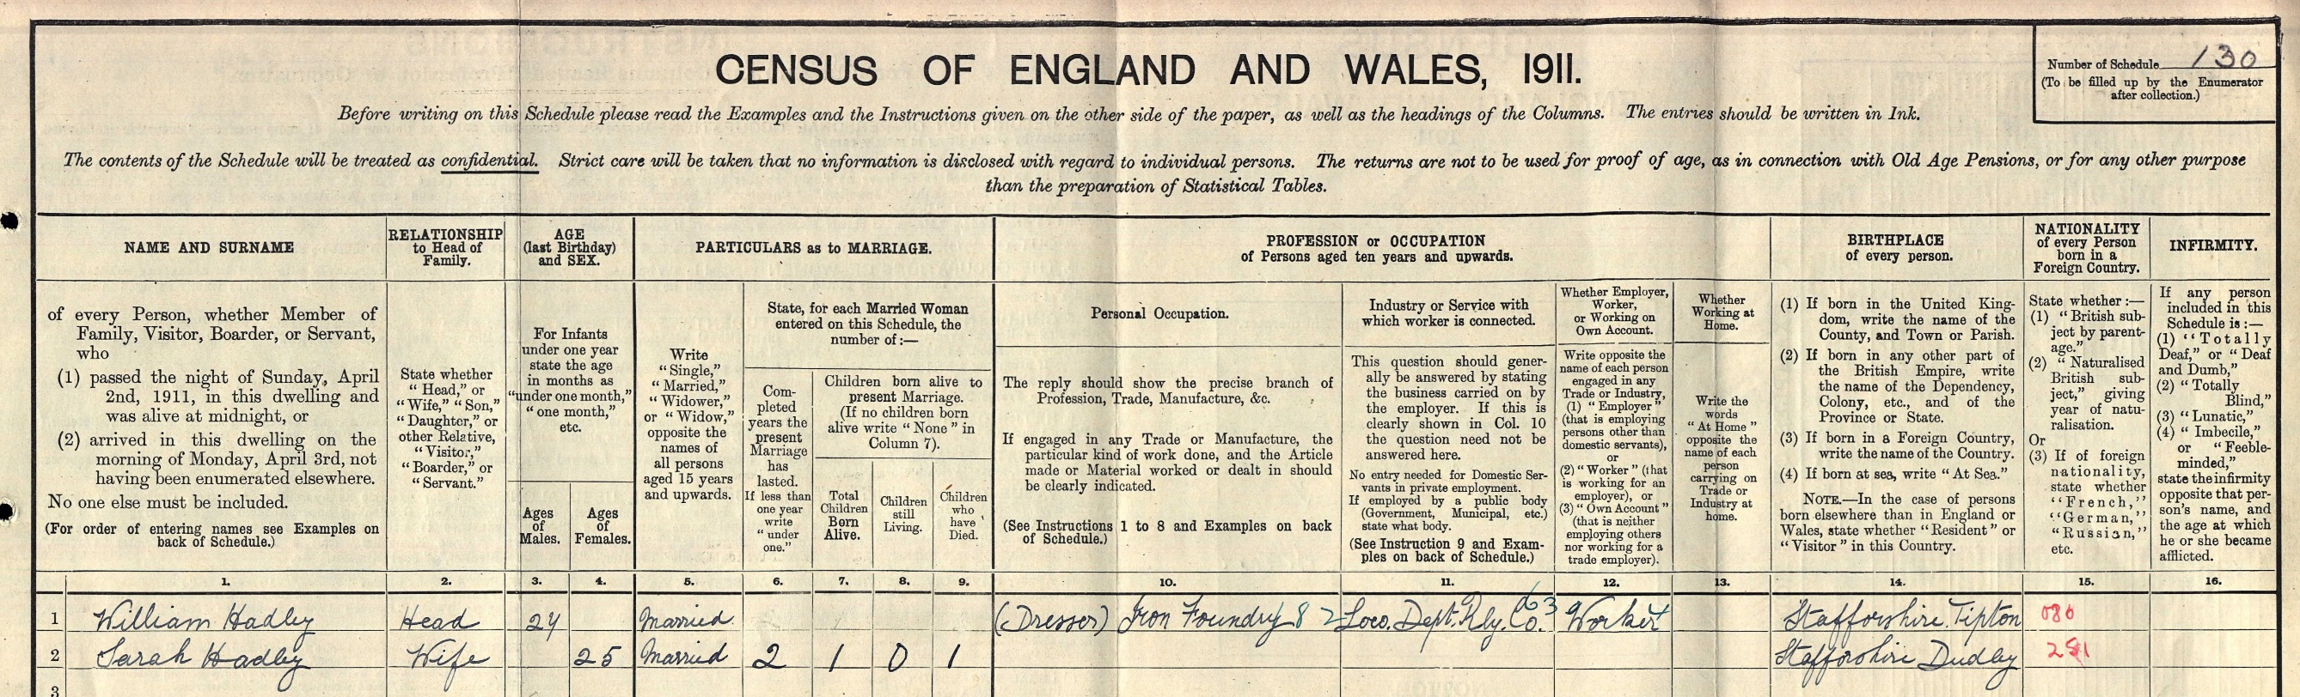
After serving for three years, he left the army but was put on what is known as the ‘reserve list’ – to be called up in the event of a war. He returned to his trade in an iron foundry. He married Sarah Bowater.

Slide 7
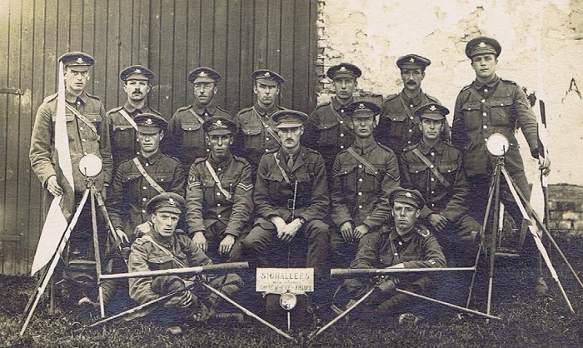
© Mercian Regiment Museum (Worcs.)
When war broke out in 1914 William was recalled to the Worcestershire Regiment and served in the 2nd Battalion as a Signaller.

Slide 8
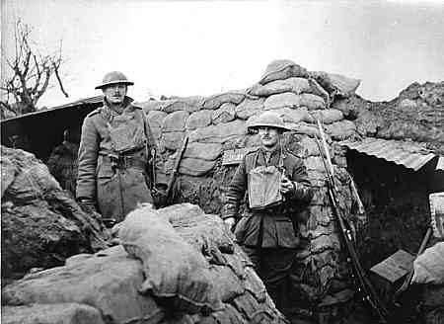
© Mercian Regiment Museum (Worcs.)
William was part of the British Expeditionary Force (BEF), the first troops to fight in France. Very soon Trench Warfare had developed along the Western Front.

Slide 9
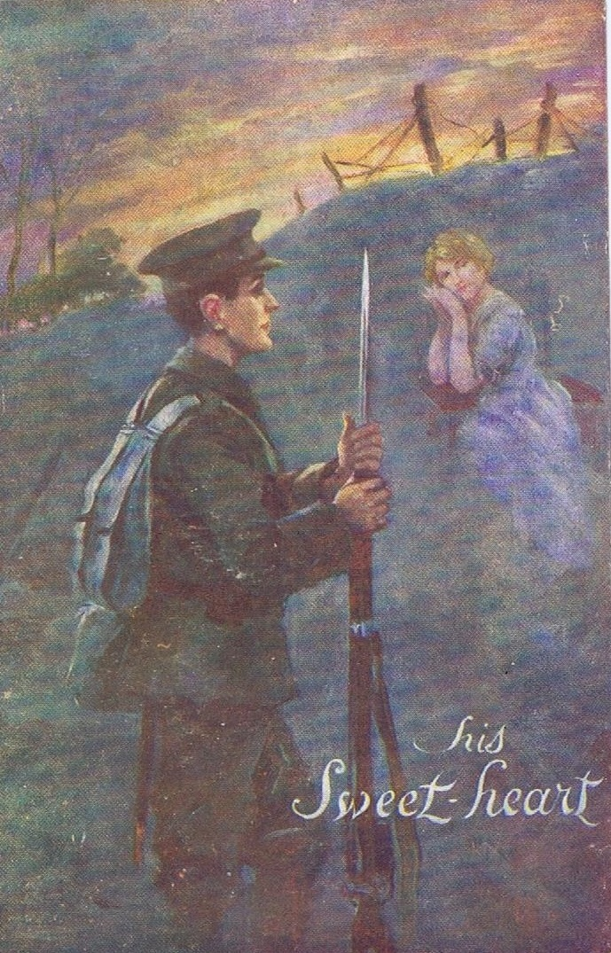
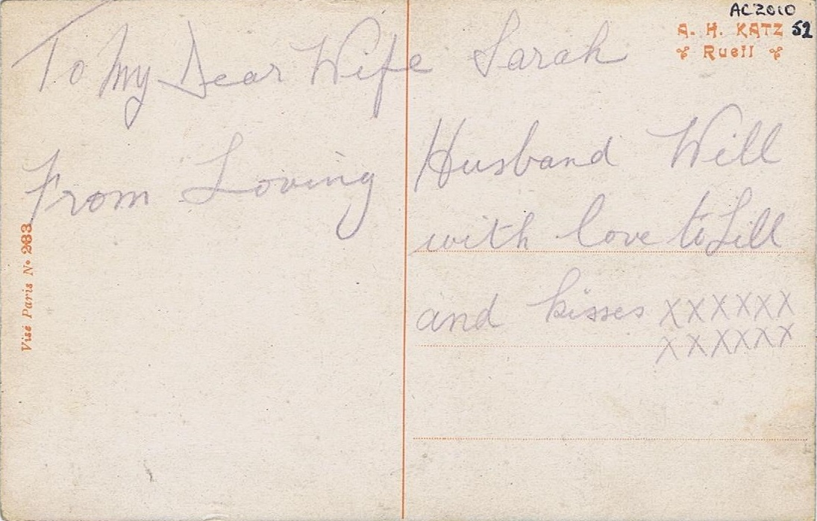
© Mercian Regiment Museum (Worcs.)
© Mercian Regiment Museum (Worcs.)
Postcards from William to Sarah.

Slide 10
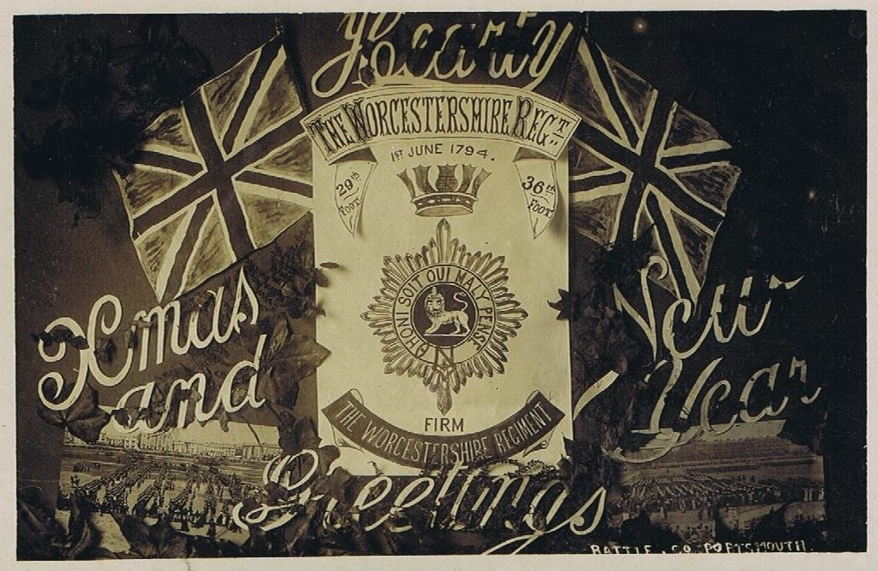
© Mercian Regiment Museum (Worcs.)

Slide 11
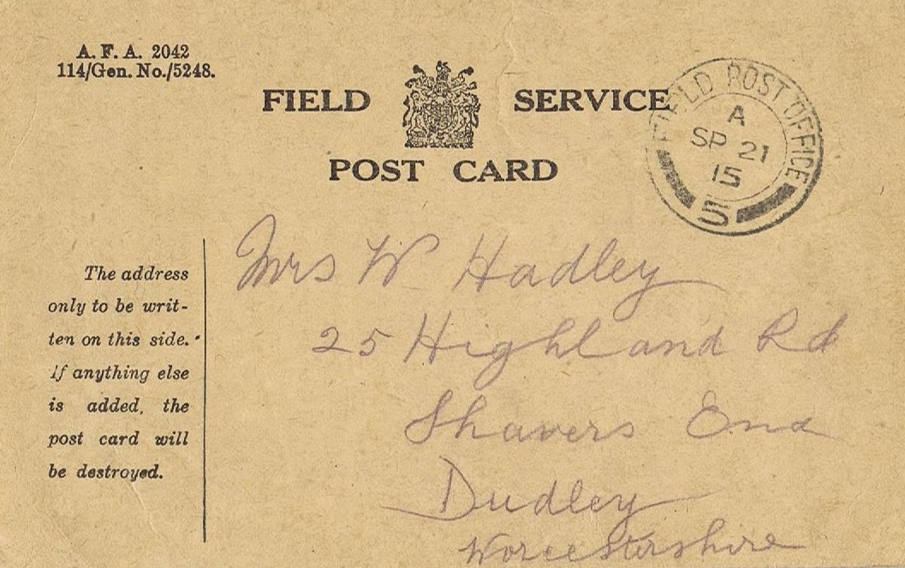
© Mercian Regiment Museum (Worcs.)

Slide 12
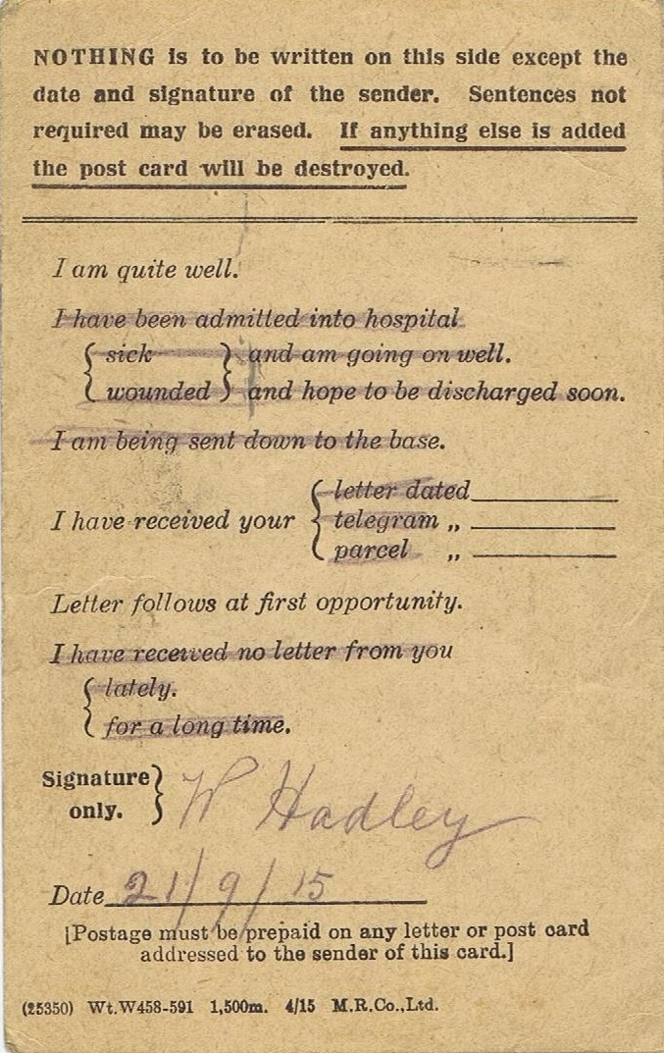
Messages were important to inform family that all was well. Likewise soldiers wanted to know about things on the Home Front.
© Mercian Regiment Museum (Worcs.)

Slide 13
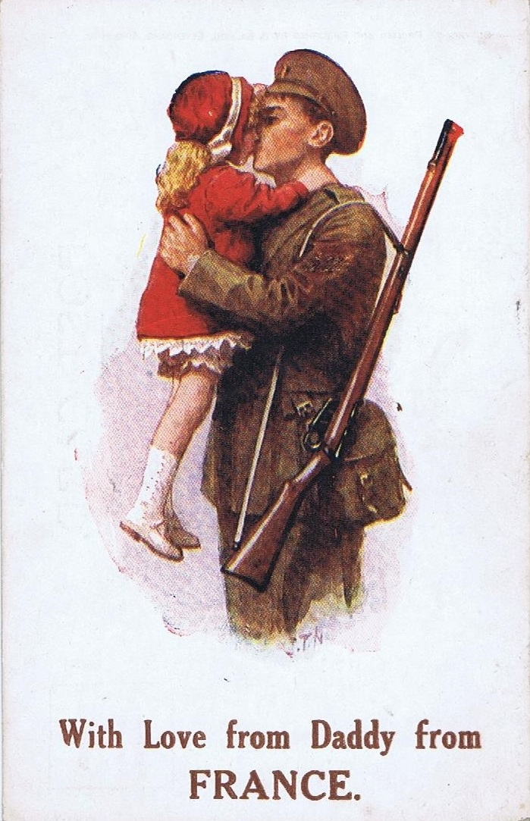
© Mercian Regiment Museum (Worcs.)
William’s first daughter, Mary, died when she was only a few weeks old after contracting whooping cough. He had another daughter Lilian in 1913.

Slide 14
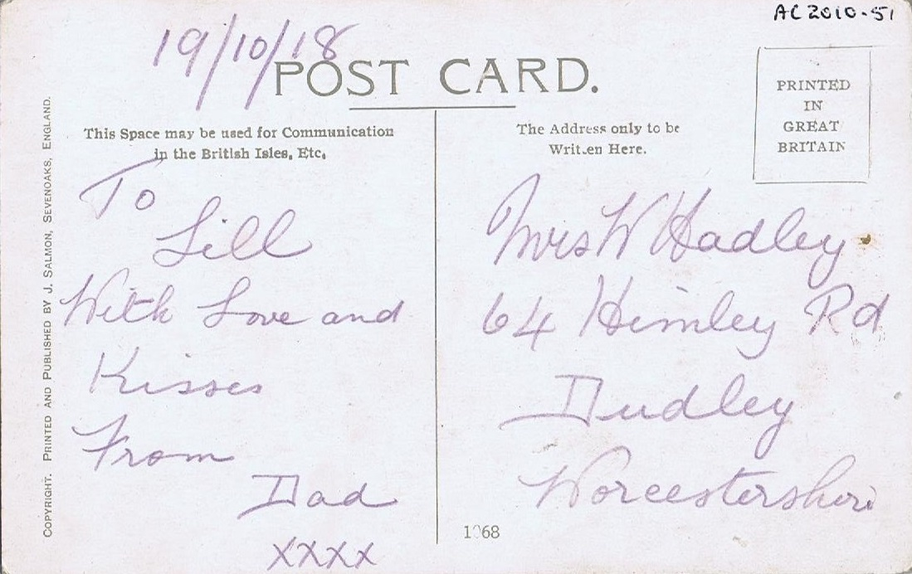
© Mercian Regiment Museum (Worcs.)

Slide 15
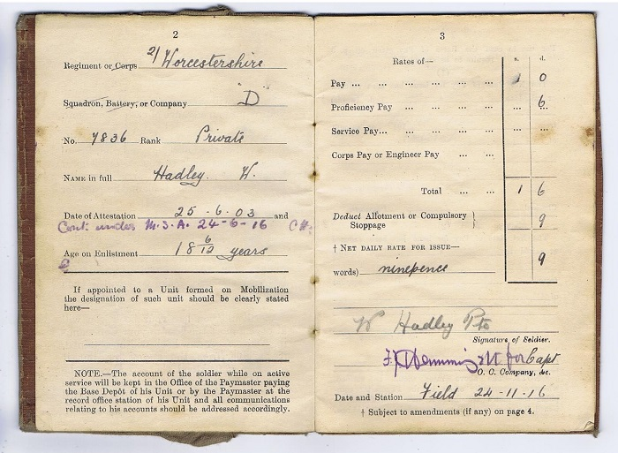
© Mercian Regiment Museum (Worcs.)
William was paid extra as a sharpshooter.

Slide 16
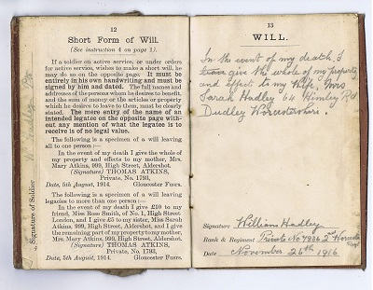
© Mercian Regiment Museum (Worcs.)

Slide 17
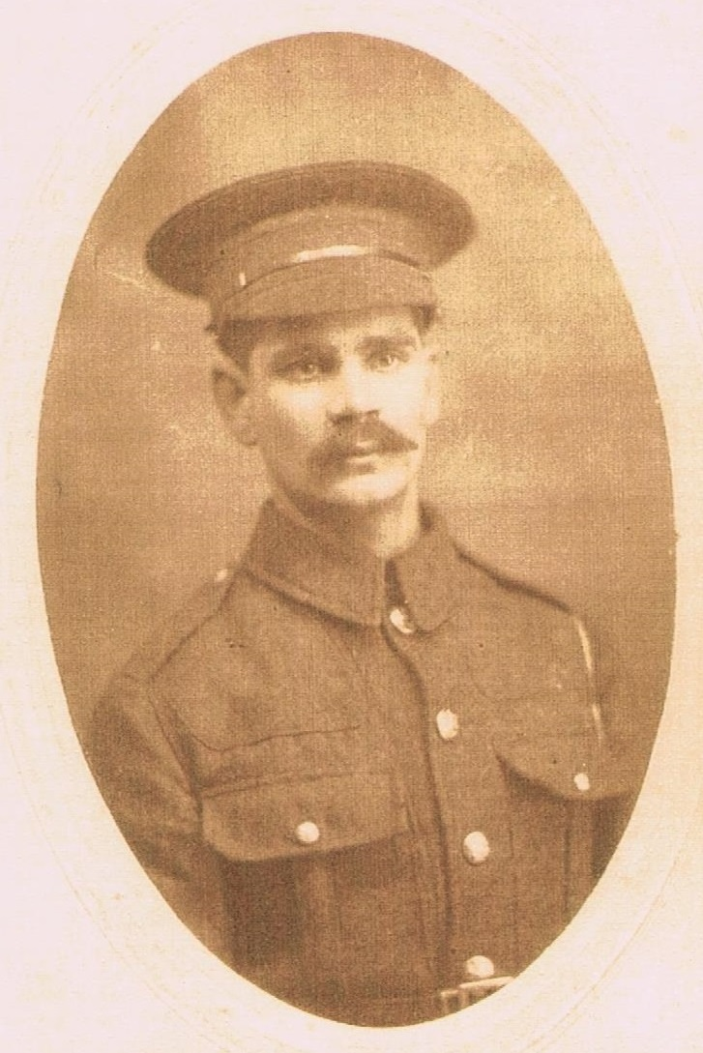
William’s younger brother Isaac was also a soldier in the Worcestershire Regiment. He was killed in Gallipoli on 29th April 1915.
© Mercian Regiment Museum (Worcs.)

Slide 18
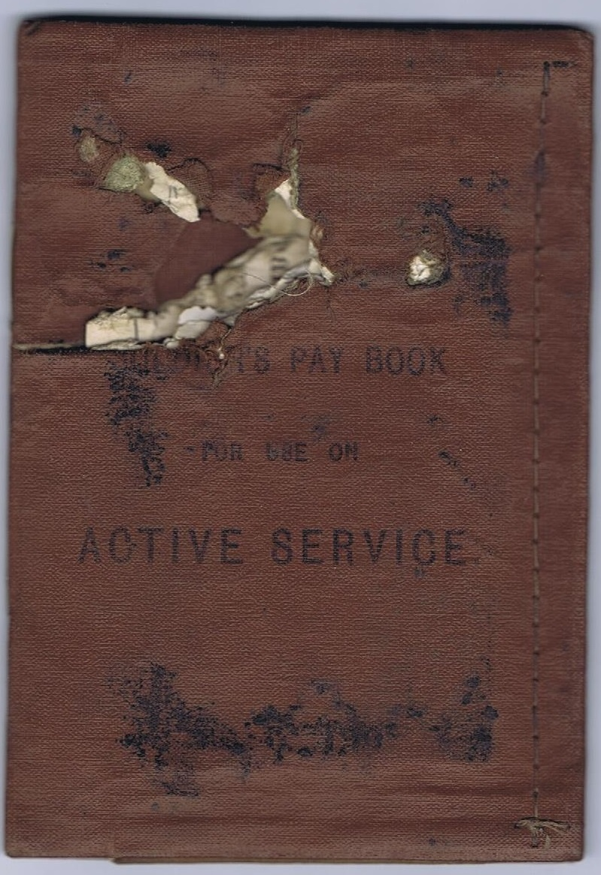
William was shot in the chest and was badly injured. The bullet went through his Army Pay Book.
© Mercian Regiment Museum (Worcs.)

Slide 19
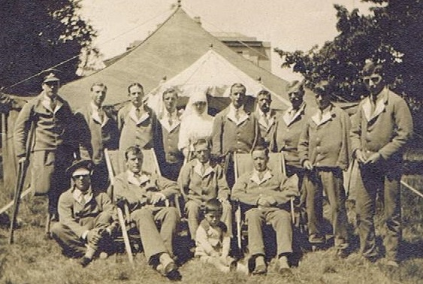
© Mercian Regiment Museum (Worcs.)
He spent time in a military hospital.

Slide 20
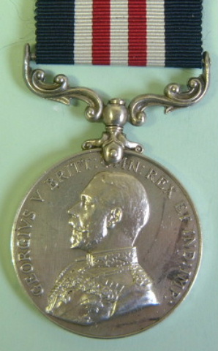
William was awarded the Military Medal for his bravery.
© Mercian Regiment Museum (Worcs.)

Slide 21
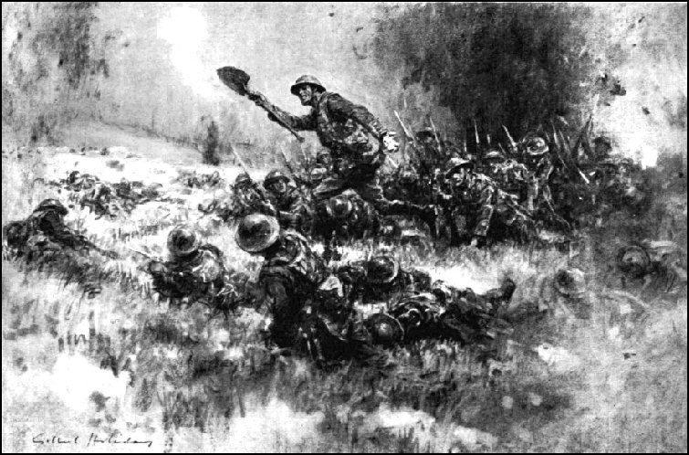
© Mercian Regiment Museum (Worcs.)
He fought alongside Eugene Paul Bennett at Transloy Ridges when he won the Victoria Cross.

Slide 22
William fought until the end of the War. The injuries he suffered during the war affected his health and he could not work for long but sadly he was not granted a disability pension. William died on 25th August 1962, aged 78.

